Slide 1
ArcGIS Online by ESRI
Heidi Gurdo, Navarun Jagatpal, Amy Mann, Cindy Marsh, Ronald Medykiewicz, Brian Nabb

Slide 2
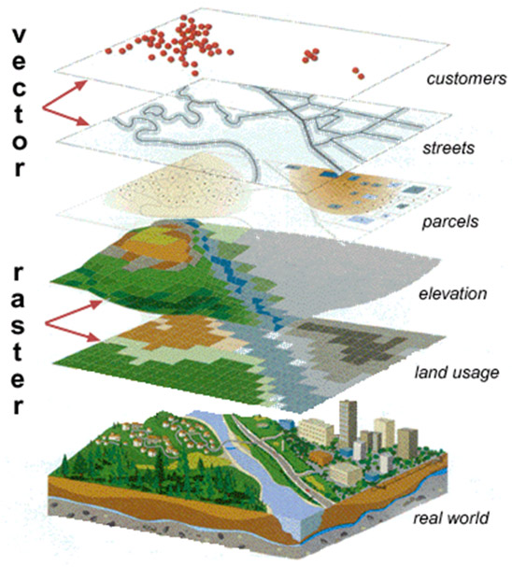
What is GIS
GIS stands for Geographic Information Systems
It is a way to view data spatially or geographically
(n.d.). Retrieved April 27, 2015, from http://ssnds.uwo.ca/sscnetworkupdate/2006winter/images/gis.jpg

Slide 3
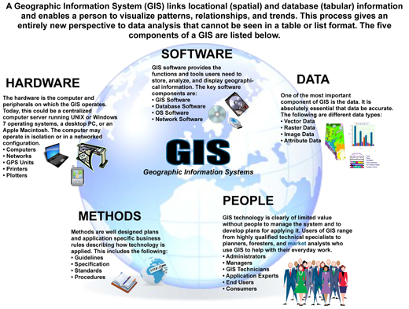
Components of GIS
(n.d.). Retrieved April 27, 2015, from http://www.countygp.ab.ca/assets/Community/Images/5pointsOfGIS.jpg

Slide 4
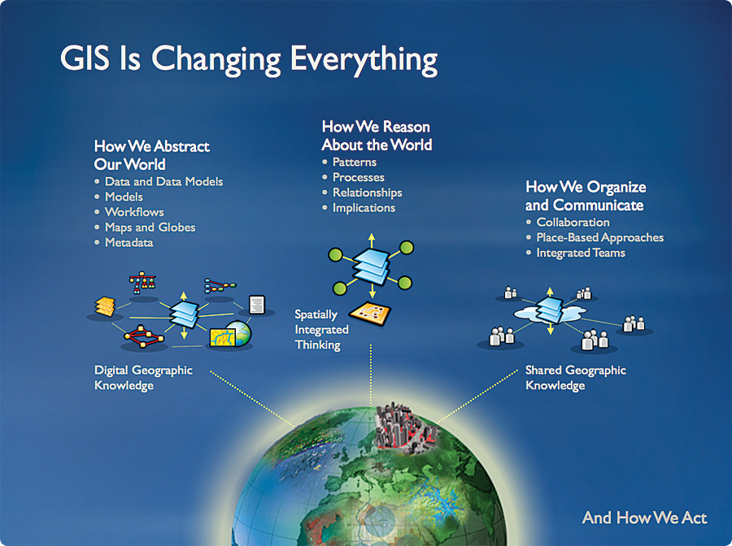
Why Does GIS Matter?
GIS connects data to maps
Helps to see data in whole new ways
Analysis
Connections
Patterns
Etc.
(n.d.). Retrieved April 27, 2015, from http://www.esri.com/news/arcnews/winter0809articles/winter0809gifs/p6p2-lg.jpg

Slide 5
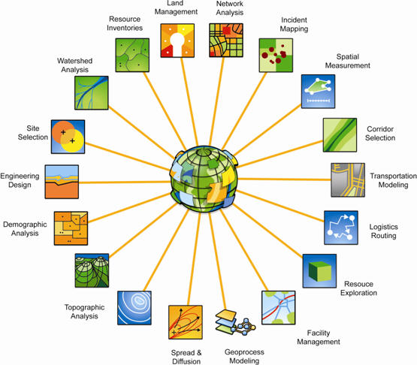
Who Uses GIS?
http://watersgeo.epa.gov/mywaterway/
http://websoilsurvey.sc.egov.usda.gov/App/WebSoilSurvey.aspx
http://www.census.gov/geography/interactive-maps.html
(n.d.). Retrieved April 27, 2015, from http://www.directionsmag.com/images/newsletter/2011/01_week1/world_lg.jpg

Slide 6
Recommended Product
ArgGIS Online: http://www.arcgis.com/features/
Two cost structures:
Free Account
All maps and content are public and searchable
Some features are not available
Education Account
All maps and content are private unless a link is provided
Costs start at $1,000 per year for 50 named uses
Cost per person decreases as the number of users increases
All features are available
Currently Del Tech has an ArcGIS Desktop License that comes with ArcGIS online access for 50 users
All Delaware K12 teachers currently have an education account

Slide 7
What Can I do with ArcGIS Online?
Browse a gallery of featured content
http://www.arcgis.com/home/gallery.html#c=esri&t=maps&o=modified
http://storymaps.esri.com/stories/2013/gettysburg/
Make your own maps
http://www.arcgis.com/home/webmap/viewer.html?useExisting=1
Share items
Organize content into groups

